Slide 1


FIT9136 PASS WEEK 8
Introduction to File Manipulation, Module, Testing and Exception Handling
9th Sep 2024
CL_33 Innovation Walk, Room C107 / Online

Slide 2

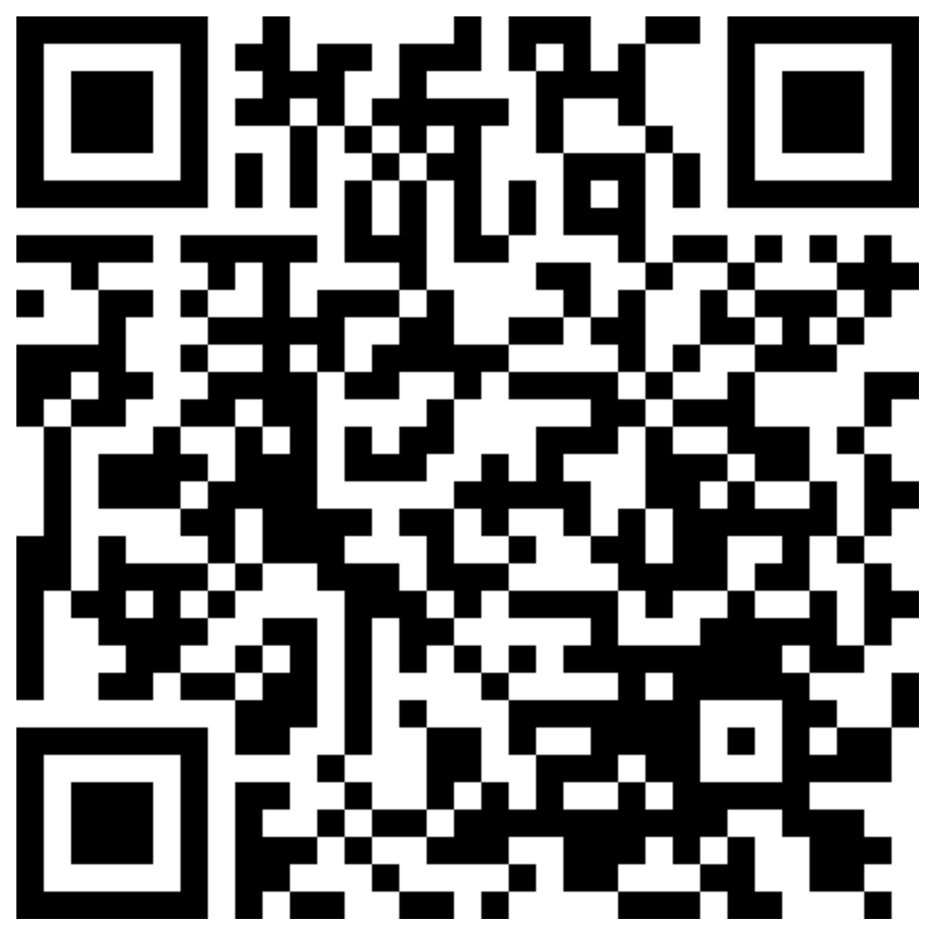
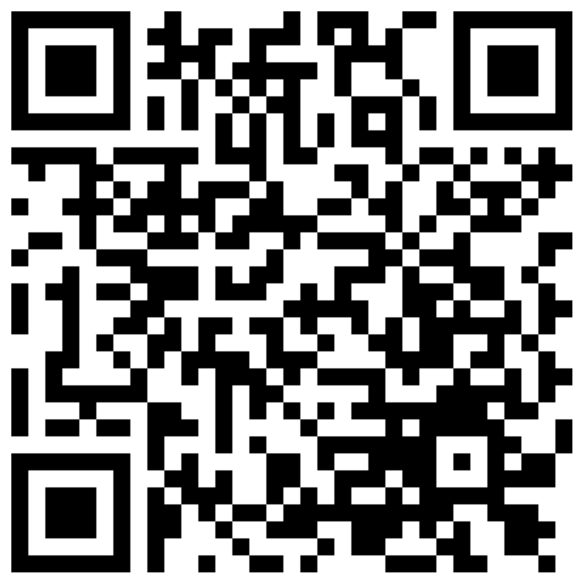
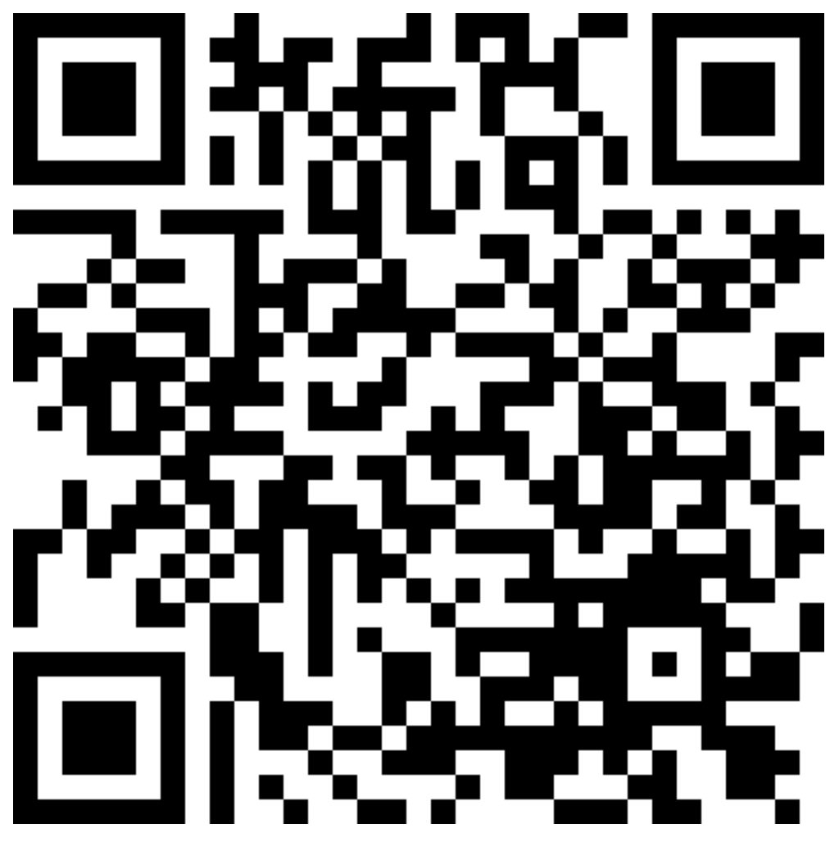

Attendance & Resources
Any questions? Email me: harry.wang1@monash.edu
Also find the drive to receive the weekly slides: https://tinyurl.com/FIT9136-PASS
Want to have GitHub Repo to access them?
SSH: git@github.com:chiefhaowang/PASS-Weekly.git
HTTPS: https://github.com/chiefhaowang/PASS-Weekly.git
Monday 2-3pm
Tuesday 9-10am
Tuesday 4-5pm

Slide 3
Agenda
01
Files & testing - 20 mins
Concept recap + practice + solution
02
Funny Leetcode & Problem Solving Section - 30 mins
03
Closure speaking - 10 mins
Conclusion + Q&A + Attendance recording

Slide 4
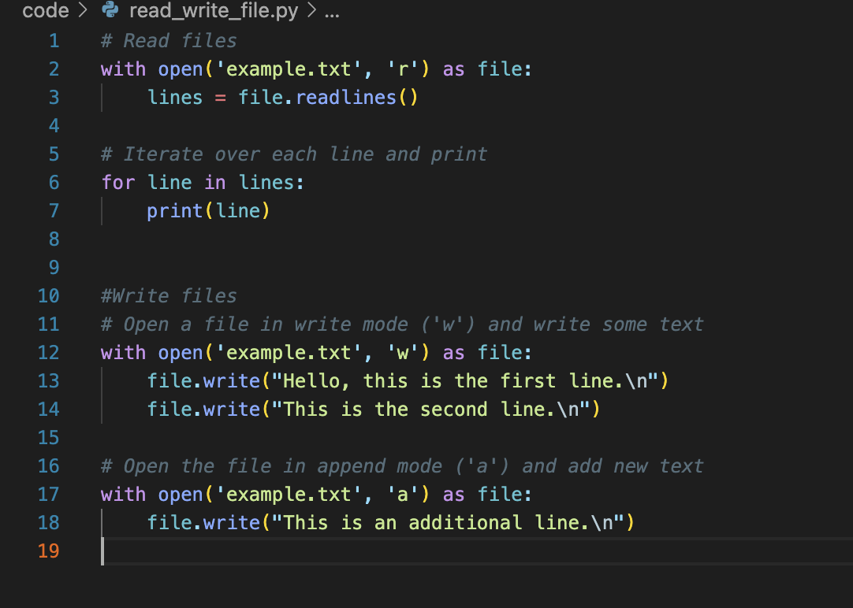
File Operations
Read & Write txt files:
'w' mode: This mode opens the file for writing. If the file already exists, it will be overwritten.
'a' mode: This mode opens the file for appending. New content is added to the end of the file, without deleting the existing content.
'r' mode: This mode opens the file for reading. The entire content of the file is read into the variable content.
with: The with statement ensures the file is properly closed after writing, even if an error occurs.
Base Code: https://tinyurl.com/FIT9136-PASS
/Week8/code/read_write_files.py

Slide 5
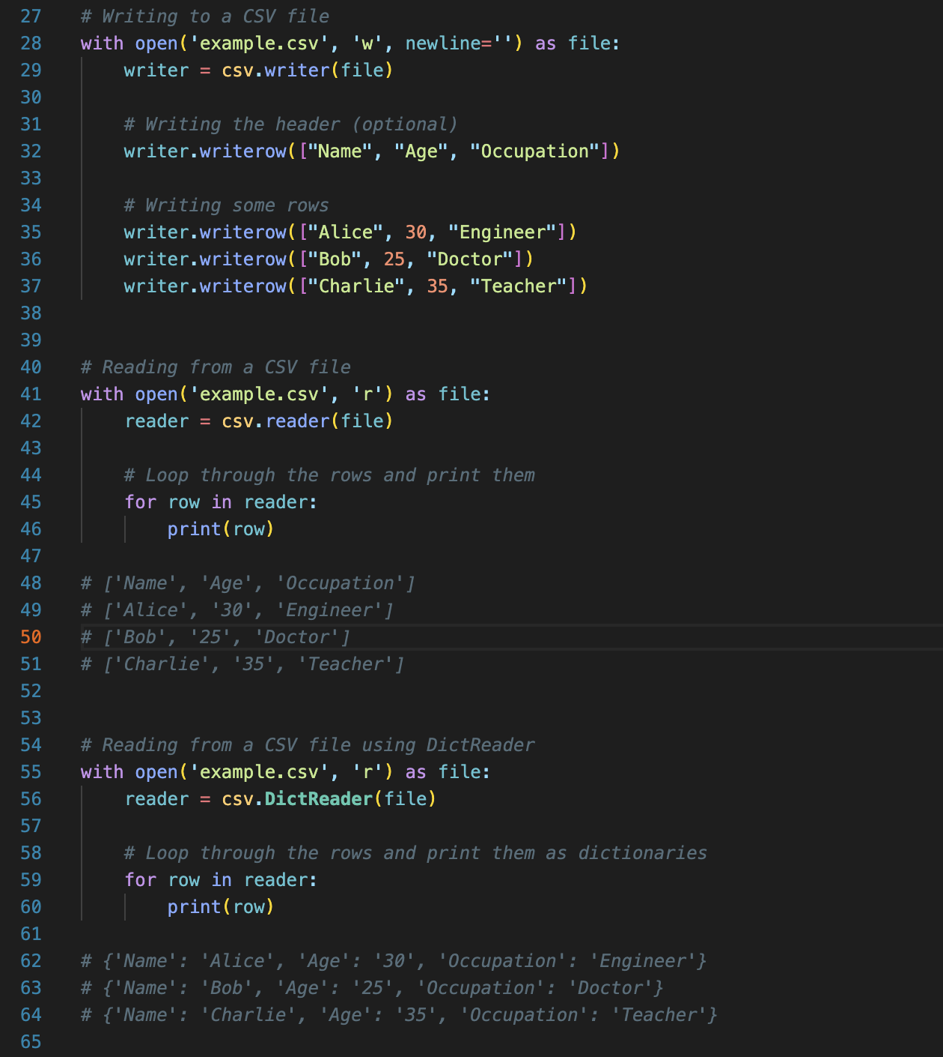
File Operations
csv.writer(): Creates a CSV writer object that is used to write data to the CSV file.
writer.writerow(): Writes a single row to the CSV file. Each row should be passed as a list.
csv.reader(): Creates a CSV reader object that reads the CSV file line by line.
csv.DictReader(): Reads the file as rows of dictionaries, where the first row is treated as column headers.
Base Code: https://tinyurl.com/FIT9136-PASS
/Week8/code/read_write_files.py

Slide 6
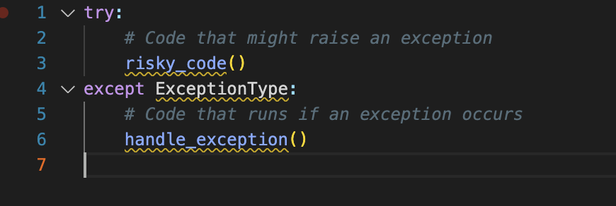
Testing - try/except
In Python, the try and except blocks are used to handle exceptions (errors that occur during program execution). Instead of the program terminating when an error occurs, you can “catch” the error and handle it gracefully, allowing the program to continue running or to display a custom error message.

Slide 7
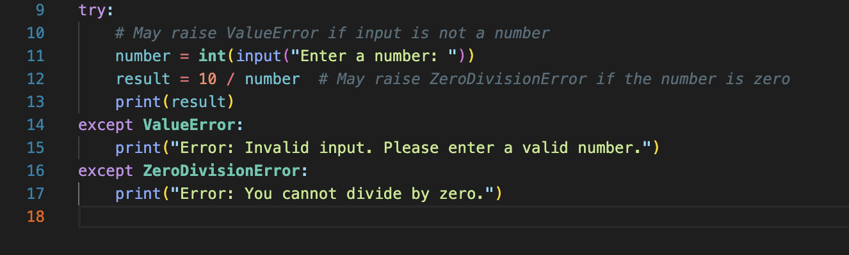
Testing - try/except

Slide 8
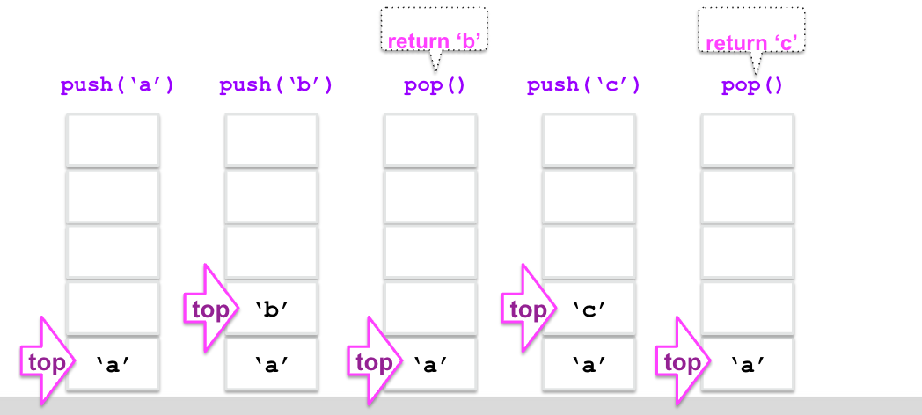
Leetcode - Stack
Task:
Implement the stack manually without using stack methods
Implement the base code
Base Code: https://tinyurl.com/FIT9136-PASS
/Week8/code/stack.py
Files are in same name on GitHub

Slide 9
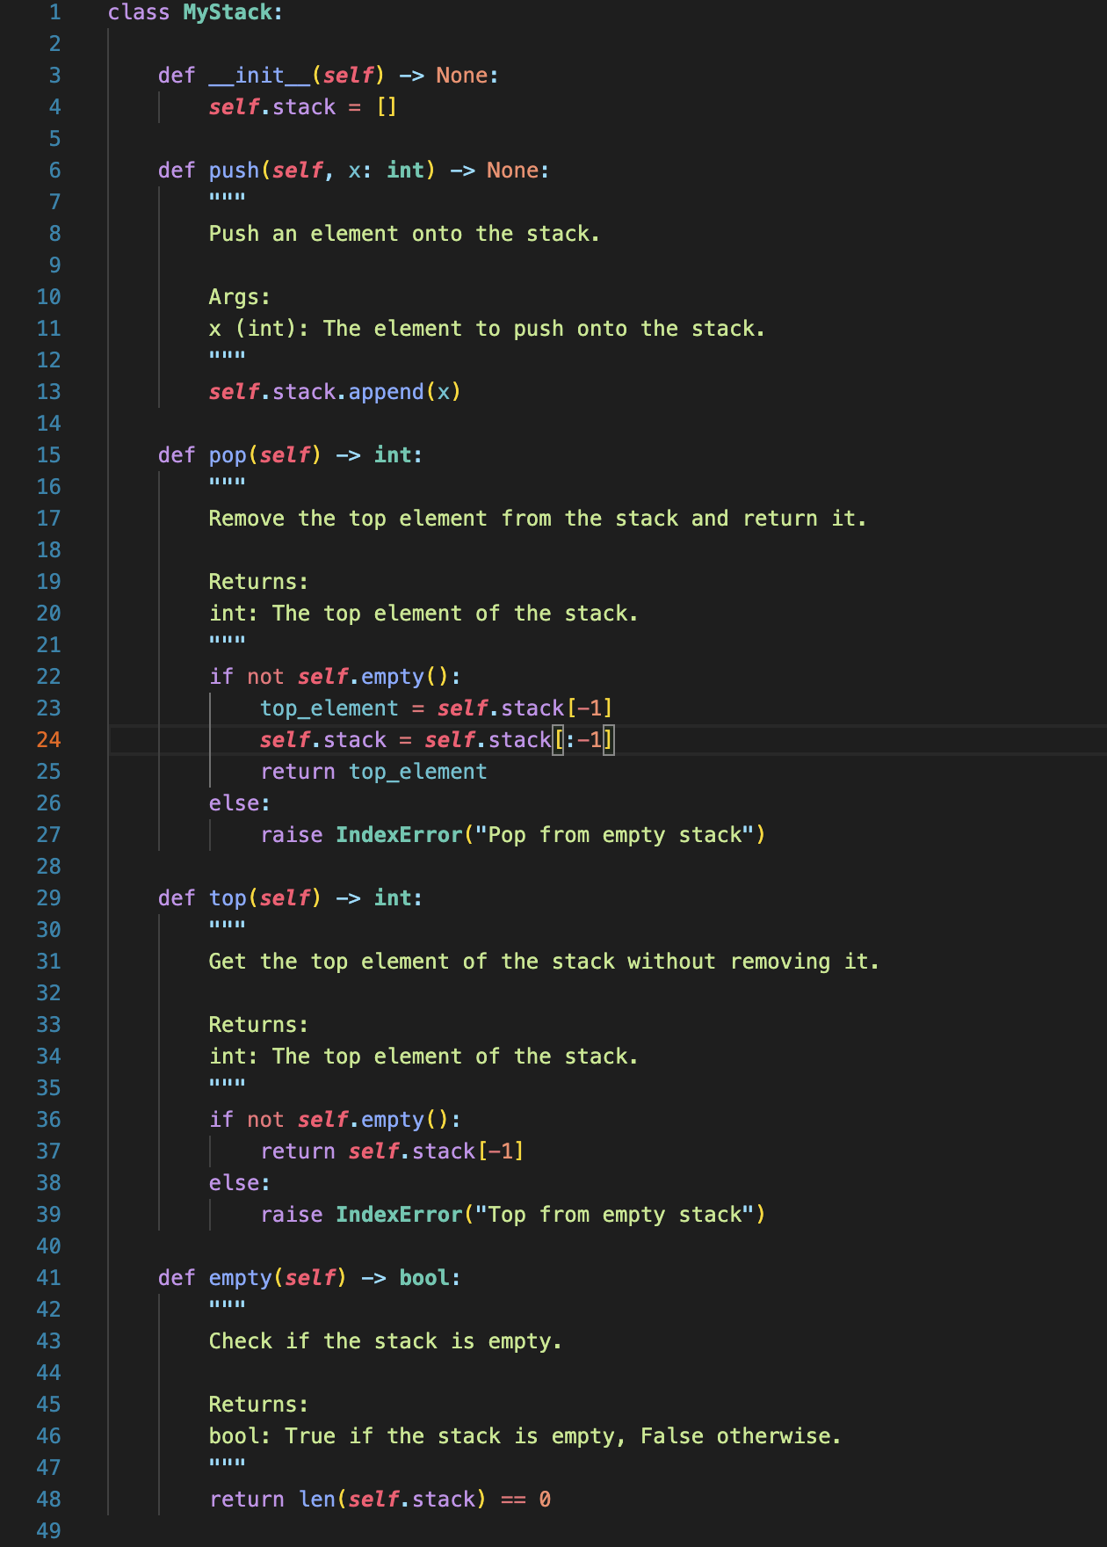
Leetcode - Stack
Base Code: https://tinyurl.com/FIT9136-PASS
/Week8/code/stack_solution.py
Files are in same name on GitHub

Slide 10
Problem Solving Section - Class Design & Testing
Material Description: https://tinyurl.com/FIT9136-PASS/Week8/problem_solving_section_desc.docx
Solution: https://tinyurl.com/FIT9136-PASS/Week8/student_management
Test cases: https://tinyurl.com/FIT9136-PASS/Week8/student_management/test.py
Files are in same name on GitHub

Slide 11

Let’s see what we got today
How to read and write txt & csv?
How to use try & exception?
How to implement an abstract logic by coding?
How to summarise the user requirement into the class implementation?

Slide 12
Attendance & Resources
Any questions? Email me: harry.wang1@monash.edu
Also find the drive to receive the weekly slides: https://tinyurl.com/FIT9136-PASS
Want to have GitHub Repo to access them?
SSH: git@github.com:chiefhaowang/PASS-Weekly.git
HTTPS: https://github.com/chiefhaowang/PASS-Weekly.git
Monday 2-3pm
Tuesday 9-10am
Tuesday 4-5pm

Slide 13
Thank You
9th Sep 2024
CL_33 Innovation Walk, Room C107 / Online

Slide 14
Questions & Answers
9th Sep 2024
CL_33 Innovation Walk, Room C107 / Online

